Slide 1
Power to change
A Message Series on the
Book of Romans

Slide 2
God’s purpose for my life
Romans 8:28-31
Part 24

Slide 3
“And we know that in all things God works for the good of those who love him, who have been called according to his purpose. For those God foreknew he also predestined to be conformed to the image of his Son, that he might be the firstborn among many brothers and sisters. And those he predestined, he also called; those he called, he also justified; those he justified, he also glorified…

Slide 4
“What, then, shall we say in response to these things? If God is for us, who can be against us?”
Genesis 3:17-19 (NIV)

Slide 5
I. God’s Promise

Slide 6
“And we know that in all things God works for the good of those who love him, who have been called according to his purpose.”
Romans 8:28 (NIV)

Slide 7
“And we know that in all things God works for the good of those who love him, who have been called according to his purpose.”
Romans 8:28 (NIV)

Slide 8
“And we know that in all things God works for the good of those who love him, who have been called according to his purpose.”
Romans 8:28 (NIV)

Slide 9
“And he who searches our hearts knows the mind of the Spirit, because the Spirit intercedes for God’s people in accordance with the will of God.”
Romans 8:27 (NIV)

Slide 10
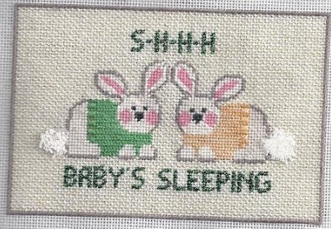

Slide 11
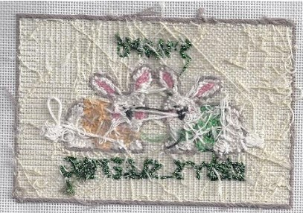

Slide 12
“The wages of sin is death.”
Romans 6:23 (NIV)

Slide 13
God’s Promise
God’s Purpose

Slide 14
“For those God foreknew he also predestined to be conformed to the image of his Son, that he might be the firstborn among many brothers and sisters.”
Romans 8:29 (NIV)

Slide 15
“Then God said, ‘Let us make mankind in our image, in our likeness, so that they may rule over the fish in the sea and the birds in the sky, over the livestock and all the wild animals, and over all the creatures that move along the ground.’ So God created mankind in his own image, in the image of God he created them; male and female he created them.”
Genesis 1:26-27 (NIV)

Slide 16
“Sanctify them by the truth; your word is truth.”
John 17:17 (NIV)

Slide 17
“In everything give thanks for this is the will of God.”
1 Thessalonians 5:18 (NIV)

Slide 18
God’s Promise
God’s Purpose
God’s Process

Slide 19
“For those God foreknew he also predestined to be conformed to the image of his Son, that he might be the firstborn among many brothers and sisters. And those he predestined, he also called; those he called, he also justified; those he justified, he also glorified.”
Romans 8:29-30 (NIV)

Slide 20
God’s Process
1. Foreknew

Slide 21
“For those God foreknew he also predestined to be conformed to the image of his Son, that he might be the firstborn among many brothers and sisters. And those he predestined, he also called; those he called, he also justified; those he justified, he also glorified.”
Romans 8:29-30 (NIV)

Slide 22
God’s Process
1. Foreknew
2. Predestined

Slide 23
“For those God foreknew he also predestined to be conformed to the image of his Son, that he might be the firstborn among many brothers and sisters. And those he predestined, he also called; those he called, he also justified; those he justified, he also glorified.”
Romans 8:29-30 (NIV)

Slide 24
“For those God foreknew he also predestined to be conformed to the image of his Son, that he might be the firstborn among many brothers and sisters. And those he predestined, he also called; those he called, he also justified; those he justified, he also glorified.”
Romans 8:29-30 (NIV)

Slide 25
“He is patient with you, not wanting anyone to perish.”
2 Peter 3:9 (NIV)

Slide 26
“Being confident of this, that he who began a good work in you will carry it on to completion until the day of Christ Jesus.”
Philippians 1:6 (NIV)

Slide 27
God’s Process
1. Foreknew
2. Predestined
3. Called

Slide 28
“For those God foreknew he also predestined to be conformed to the image of his Son, that he might be the firstborn among many brothers and sisters. And those he predestined, he also called; those he called, he also justified; those he justified, he also glorified.”
Romans 8:29-30 (NIV)

Slide 29
“We love because he first loved us.”
John 4:19 (NIV)

Slide 30
God’s Process
1. Foreknew
2. Predestined
3. Called
4. Justified

Slide 31
“For those God foreknew he also predestined to be conformed to the image of his Son, that he might be the firstborn among many brothers and sisters. And those he predestined, he also called; those he called, he also justified; those he justified, he also glorified.”
Romans 8:29-30 (NIV)

Slide 32
Just-as-if-I’d

Slide 33
God’s Process
1. Foreknew
2. Predestined
3. Called
4. Justified
5. Glorified

Slide 34
“For those God foreknew he also predestined to be conformed to the image of his Son, that he might be the firstborn among many brothers and sisters. And those he predestined, he also called; those he called, he also justified; those he justified, he also glorified.”
Romans 8:29-30 (NIV)

Slide 35
God’s Promise
God’s Purpose
God’s Process
Our Response

Slide 36
“What, then, shall we say in response to these things? If God is for us, who can be against us?”
Romans 8:31 (NIV)

Slide 37
IV. Our Response

Slide 38
IV. Our Response
1. Trust

Slide 39
IV. Our Response
1. Trust
2. Submission

Slide 40
IV. Our Response
1. Trust
2. Submission
3. Contentment

Slide 41
IV. Our Response
1. Trust
2. Submission
3. Contentment
4. Thankfulness

Slide 42
IV. Our Response
1. Trust
2. Submission
3. Contentment
4. Thankfulness
5. Praise

